Slide 1
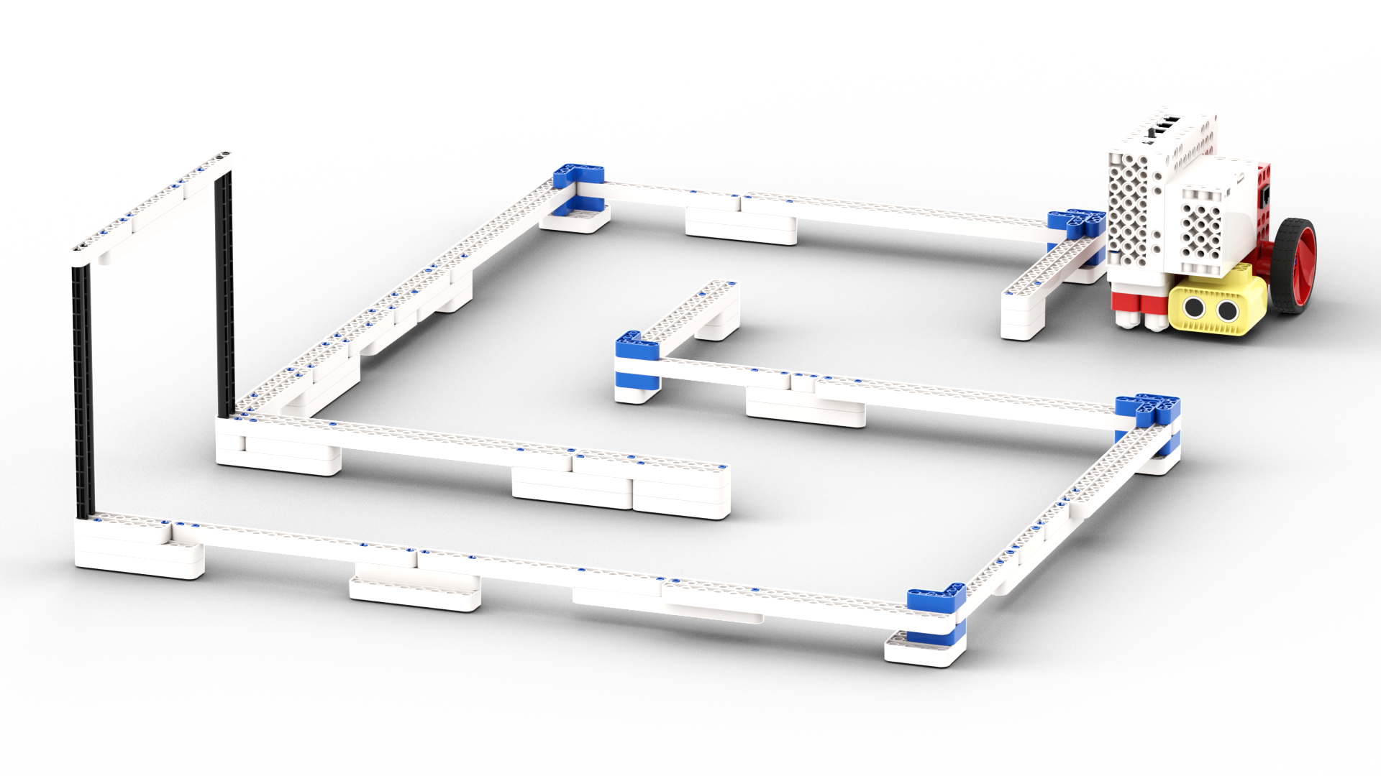
MAZE CRAZE

Slide 2
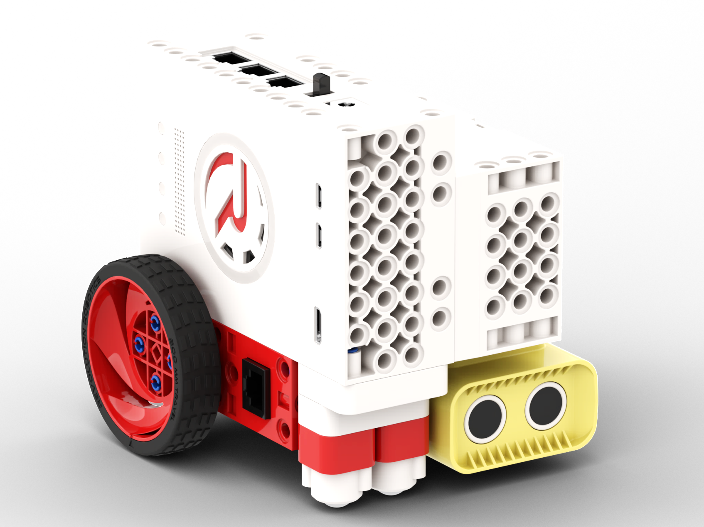
Build the Robot

Slide 3
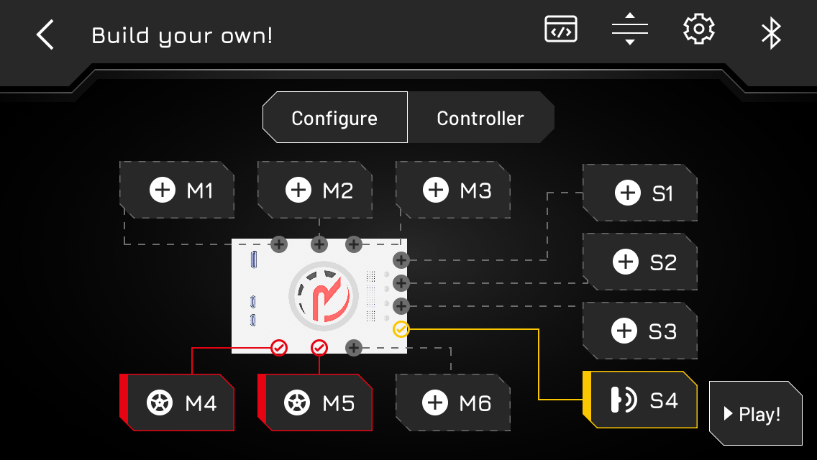
Configure the Robot
M4 drive RIGHT
M5 drive LEFT
S4 DISTANCE SENSOR

Slide 4
Build the Maze

Slide 5
Speed Challenge
Drive the Robot through the maze.
Start from the yellow rectangle.
Minus 5 seconds for touching a wall.
Good Luck!
START

Slide 6
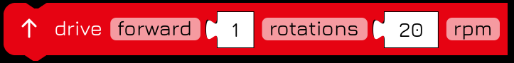
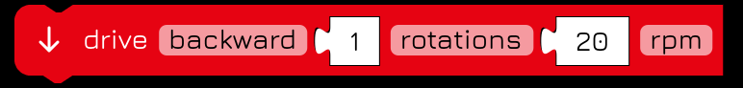
Program Controller
Program drive
FORWARD BACKWARD

Slide 7
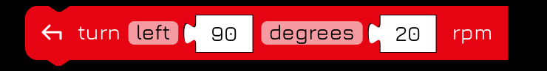
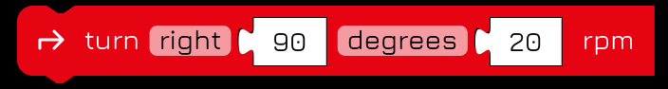
Program Controller
Program turns
90° LEFT 90° RIGHT

Slide 8
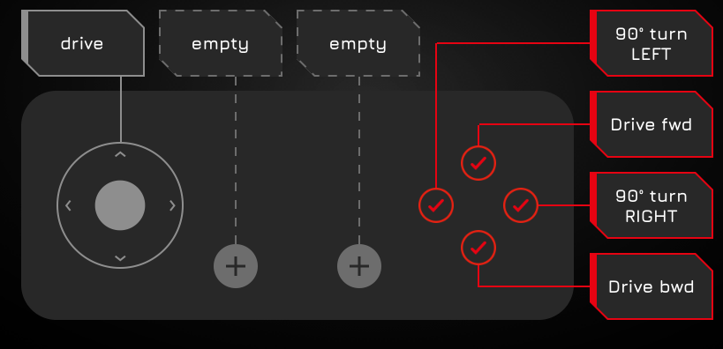
Program Controller
Drive through
the Maze
using the buttons!

Slide 9
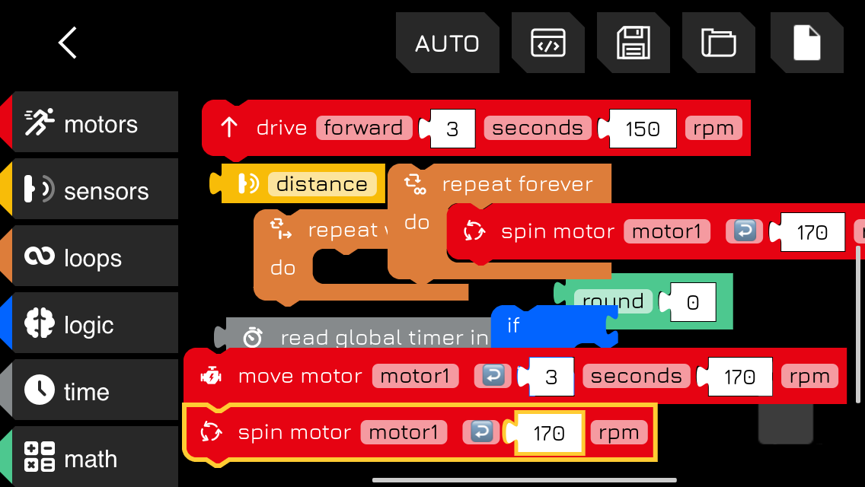
Autonomous driving
Program the Robot to
navigate The Maze
on it’s own

Slide 10
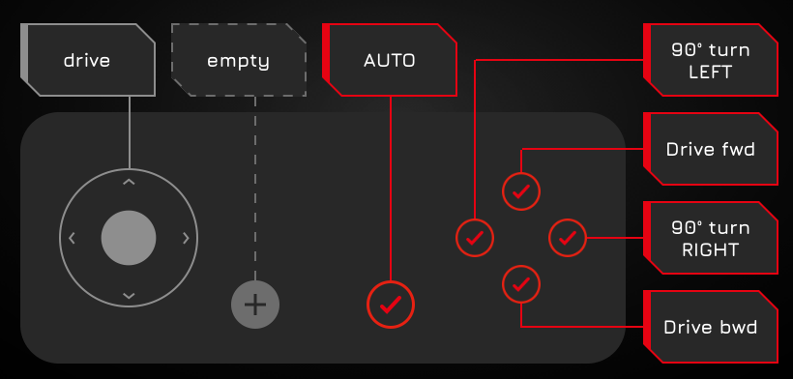
Autonomous driving
Drive through
the Maze
using the
AUTO button!

